Slide 1
PORTFOLIO SUBMISSION Applied Data Sciences
Joyce Woznica SID: 37463397
Notes:
Welcome to my portfolio review for my graduation from Syracuse University Applied Data Sciences Masters program.

Slide 2
AGENDA
01 Why we are here
02 The Syracuse ADS Program
03 Key Projects
04 Summary
05 Reflection
Notes:
So quickly – let’s review the agenda for this presentation.
First, I’ll introduce you to why you are listening to this (and yes, why my slides have horses on them).
Next, I’ll explain the learning objectives for the Applied Data Science Program at Syracuse University.
Then I’ll talk about how I satisfied these learning objectives with some key projects in my course work.
Then I will do a brief summary of these projects and objectives and then finish up with some reflection.

Slide 3
01
Why we are here
Understanding what got me to the program
Notes:
Let’s start with what got me in this position

Slide 4

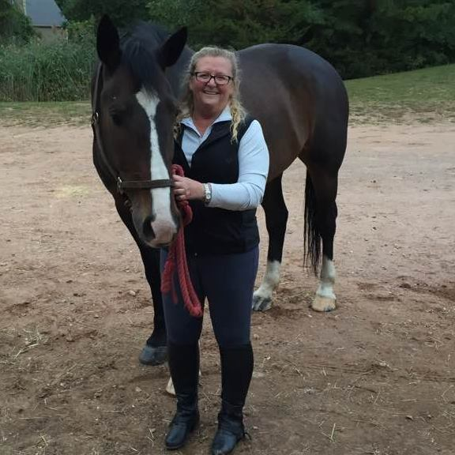

01
Why we are here
Understanding what got me to the program
My daughters are competitive equestrians.
Riding is something that they love and I love doing with them.
I have always been interested in numbers and patterns.
I was facing the empty nest.
Seemed like a great way to combine passions.
Notes:
Let me just take you back in time for a minute.
Imagine - there are six short weeks remaining in the horse show season in 2006 — my daughters and their horses are trying to hang on to their ranking so that they will qualify for state finals and year-end awards with their horses.
I have gathered data over the season for each show that they have attended which includes:
the judge
the classes entered by each daughter
which horse was ridden in each class
their placing in each class
personal comments about the judge and what he/she was looking for in each class
Using this information, I figure out which shows they should attend with judges that have placed them well in the past so that they can maximize their points for the
last six months of the season.
The outcome: they made it to state finals and placed in the top two for their year-end awards in their respective divisions.
But here’s the interesting thing - I was doing rudimentary data analytics (without the assistance of programming and machine learning) to predict the outcome of the future shows. This “manual” method was used for the remainder of my both of my daughters’ amateur junior career in the saddle.
Fast forward a decade and both girls (and their horses) are in college, and I am looking at an empty nest as a single parent. I know that work and riding my own horse will not fill the gap of dealing with teenage girls over the past several years, so I had to come up with a plan for filling my days while they were gone — enter graduate school at the age fifty-seven (a couple weeks shy of 58). I selected the Syracuse Applied Data Analytics program because it addressed applying data analytics to specific business problems to achieve an outcome.
My portfolio combines my obsession with numbers and data with my passion for horses and clearly represents my progression and acquired skills throughout the program.
And to add a personal touch:
<CLICK> My oldest daughter, Ellie
<CLICK> My youngest daughter, Lauren
<CLICK> And me – with my boy, Sullivan

Slide 5
Who am I?
Just a few points to summarize my background
I have a bachelor of arts in mathematics from Texas Tech University
I have a master of science in mathematics with a concentration in statistics also from Texas Tech University
I thought I wanted to be an actuary, but I felt it was too boring - and went into software
I am at seasoned professional with over 35 years in the workforce
I am a Six Sigma Greenbelt
I have worked with analytics in my positions at IBM and some of their partners
Notes:
Before getting started, I thought I would provide a bit of background about myself.
I have a bachelor of arts in mathematics from Texas Tech University but did spend most of those years in an Applied Mathematics program at Baylor University which included Math, Business and Computer Science
I couldn’t find a job I wanted, so I decided to stick around and get a master of science in mathematics with a concentration in statistics
I thought I wanted to be an actuary, but I felt it was too boring so I went to work for a software firm and have held many positions for various software and services companies over the years
I am at seasoned professional with over 35 years in the workforce … yes over 35 years
I got a Six Sigma Greenbelt when that was fashionable
I have had the opportunity to work with analytics when working with IBM and some IBM partners over the years

Slide 6
02
The Syracuse Applied Data Science Program
Notes:
So – enough about me … I want to take a moment to summarize the Applied Data Science program and learning objectives.

Slide 7
Program Focus Areas
Describing a broad overview of the major practice areas of data science.
Collecting and organizing data.
Identifying patterns in data via visualization, statistical analysis, and data mining.
Developing alternative strategies based on the data.
Developing a plan of action to implement the business decisions derived from the analyses.
Demonstrating communication skills regarding data and its analysis for managers, IT professionals, programmers, statisticians, and other relevant professionals in their organization.
Synthesizing the ethical dimensions of data science practice (e.g., privacy).
Notes:
The Syracuse Applied Data Science Program is a diverse program that provides students with skills in a broad of range of areas. There are seven main areas of focus that you can see listed here.
Describing a broad overview of the major practice areas of data science.
Collecting and organizing data.
Identifying patterns in data via visualization, statistical analysis, and data mining.
Developing alternative strategies based on the data.
Developing a plan of action to implement the business decisions derived from the analyses.
Demonstrating communication skills regarding data and its analysis for managers, IT professionals, programmers, statisticians, and other relevant professionals in their organization.
Synthesizing the ethical dimensions of data science practice (e.g., privacy).

Slide 8
03
Key Projects
Notes:
So – faced with all these objectives, what projects helped me achieve them?

Slide 9
Key Projects Noted
The following projects were noted to show how these seven learning objectives were satisfied:
IST 659 - Data Administration Concepts and Database Management
MBC 638 - Data Analysis and Decision Making
IST 707 - Data Analytics
IST 719 - Information Visualization
IST 652 - Scripting for Data Analytics
IST 664 - Natural Language Processing
Notes:
Ok, a little reality check – I am a more is more person and I had a very difficult time narrowing down which projects to talk about.
So, here’s my list. Trust me – it was a very difficult decision for me!
IST 659 - Data Administration Concepts and Database Management
MBC 638 - Data Analysis and Decision Making
IST 707 - Data Analytics
IST 719 - Information Visualization
IST 652 - Scripting for Data Analytics
IST 664 - Natural Language Processing

Slide 10
IST 659
Data Administration Concepts and Database Management
Professor Chad Harper
Notes:
Let’s start with Data Administration Concepts and Database Management which I took under the guidance of Chad Harper.

Slide 11
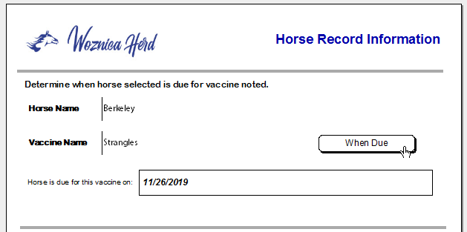
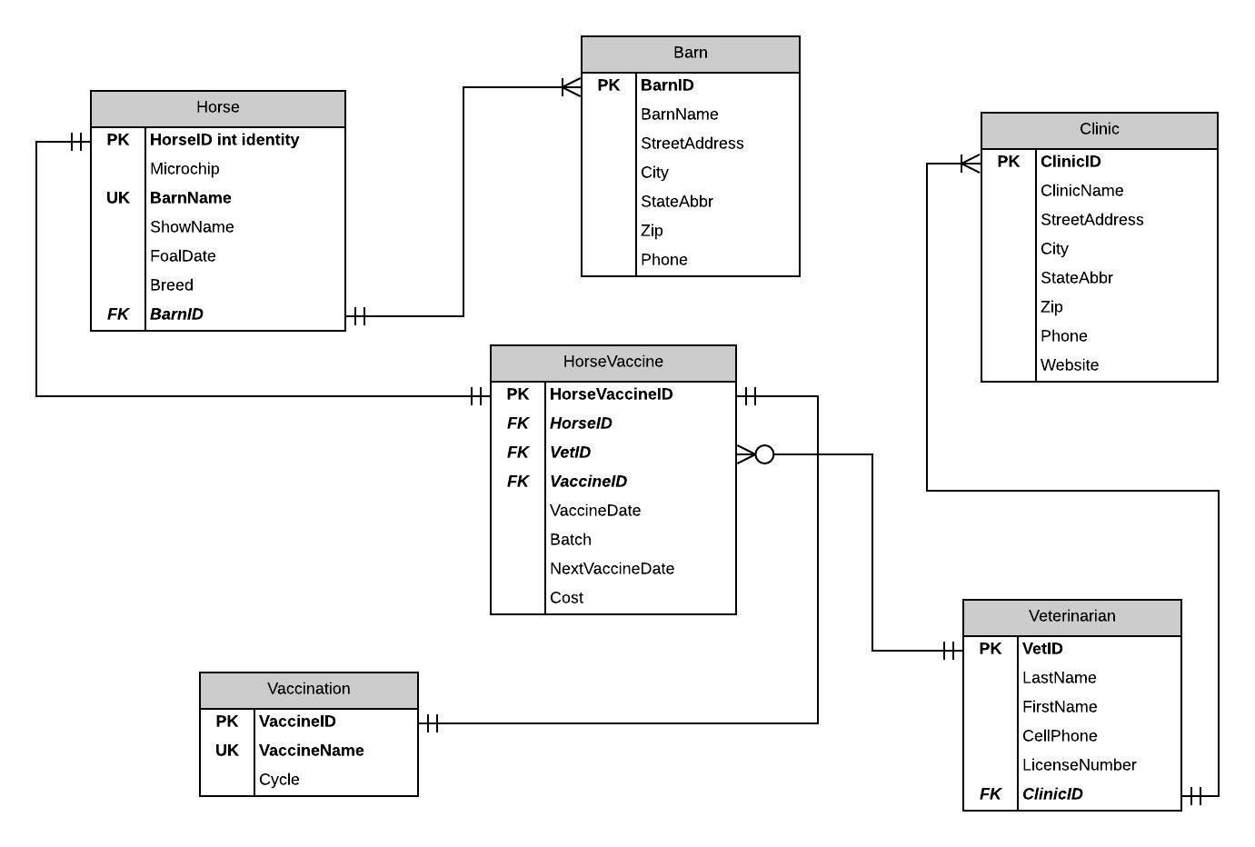
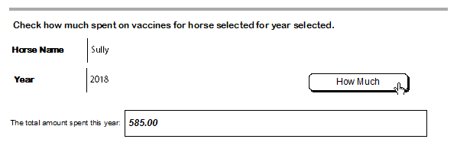
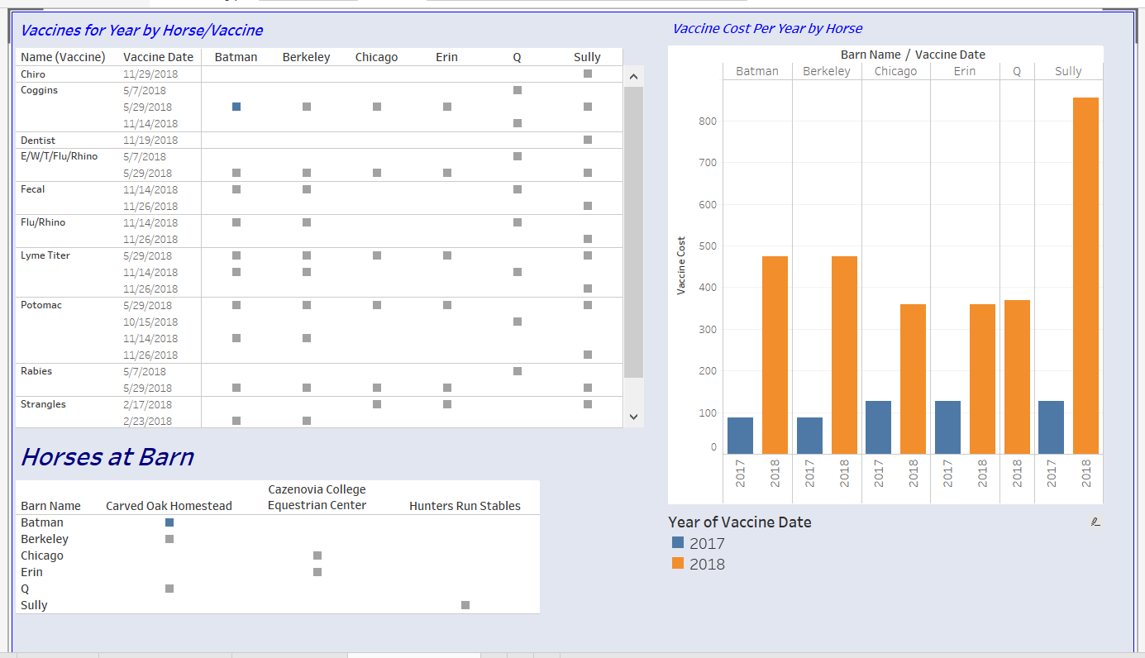
Horse Records
Replace with your own text
Notes:
Goals in this course focused on the building of a normalized database and understanding the relationship between database tables. After this was accomplished, the tables had to be created and populated. Finally, we focused on updating, modifying, deleting and reading this information to answer questions about the data.
So, I love horses and so do my daughters. So, the three of us own multiple horses in different states. We have to keep track of who is near what veterinarian, what vaccines are required when, where to get the best price not sacrificing quality, and more. By providing a single database of all the horses and their vaccine history, a solution was developed to maintain this information and provide reminders as well as recommendations for future routine work. So, I created a database that tracked of my horses’ vaccines as well as all their dentist, chiropractor and other routine medical visits.
<CLICK> This course taught me the importance of data collection and organization as I needed to merge data from multiple sources and organizing the data into a normalized database that you can see in the figure on the left.
<CLICK> <CLICK> We also worked on writing procedures to answer real-life questions like “when is my horse due for a specific vaccination?” or “how much did I spend on vaccinations in 2018?” I developed some User interfaces to allow querying the database for this type of information and then to also display information in dashboard format <CLICK>. Using visualizations proved very insightful and a great way to refine the information.
Although the plan of action for this project was limited to my plan for this course, it did position me to implement that plan of revising and fine tuning so that the end state of being able to gain insight into my horses and their costs as well as have a place to store this important data.
Finally, learning to communicate to different audiences and levels was a key objective and one that will likely be the most utilized in the future. Talking at the right level and delivering the right information is key to any project. This may prove important if I do decide to market this as a product or app in the future - just saying ☺

Slide 12
Learning Objectives Satisfied
Collecting and organization data
Identifying patterns in data via visualization, statistical analysis, and data mining
Developing a plan of action to implement the business decisions derived from analysis
Demonstrating communication skills regarding data and its analysis for managers, IT professionals, programmers, statisticians, and other relevant professionals in their organization
Notes:
To summarize, the following learning objectives were satisfied by the project work in MBC 638 - Data Analysis and Decision Making
Collecting and organization data
Identifying patterns in data via visualization, statistical analysis, and data mining
Developing a plan of action to implement the business decisions derived from analysis
Demonstrating communication skills regarding data and its analysis for managers, IT professionals, programmers, statisticians, and other relevant professionals in their organization

Slide 13
MBC 638
Data Analysis and Decision Making
Professor Lynn Gill
Notes:
So let’s move onto the next class that was instrumental in satisfying various learning objectives in the Syracuse program was Data Analysis and Decision Making with Lynn Gill.

Slide 14
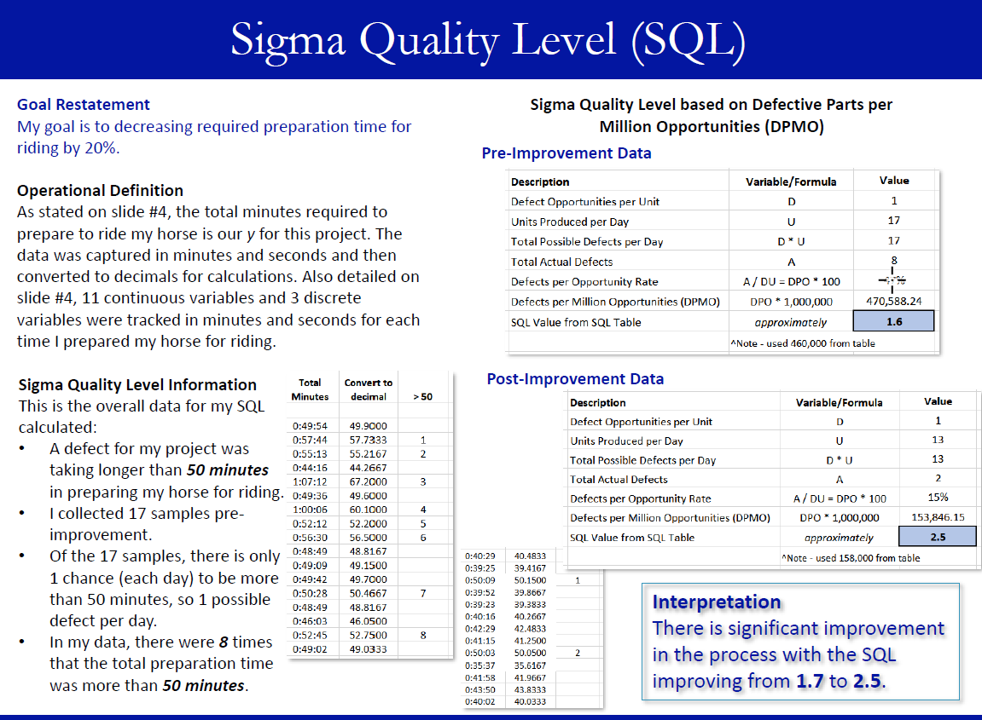
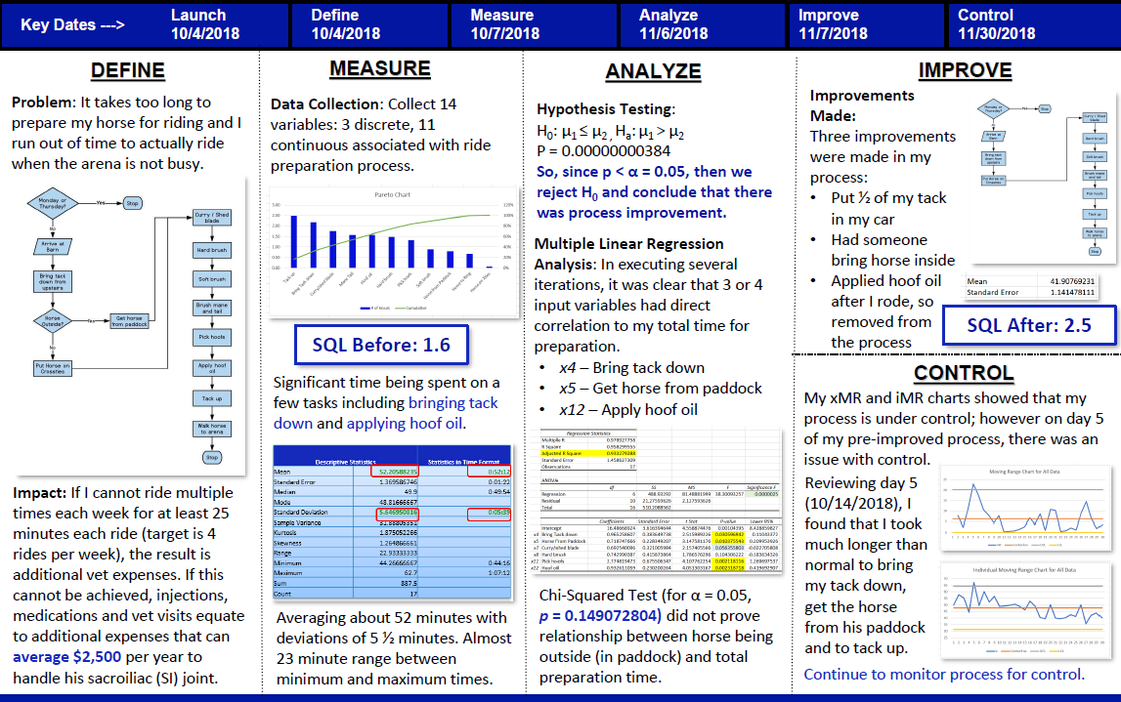
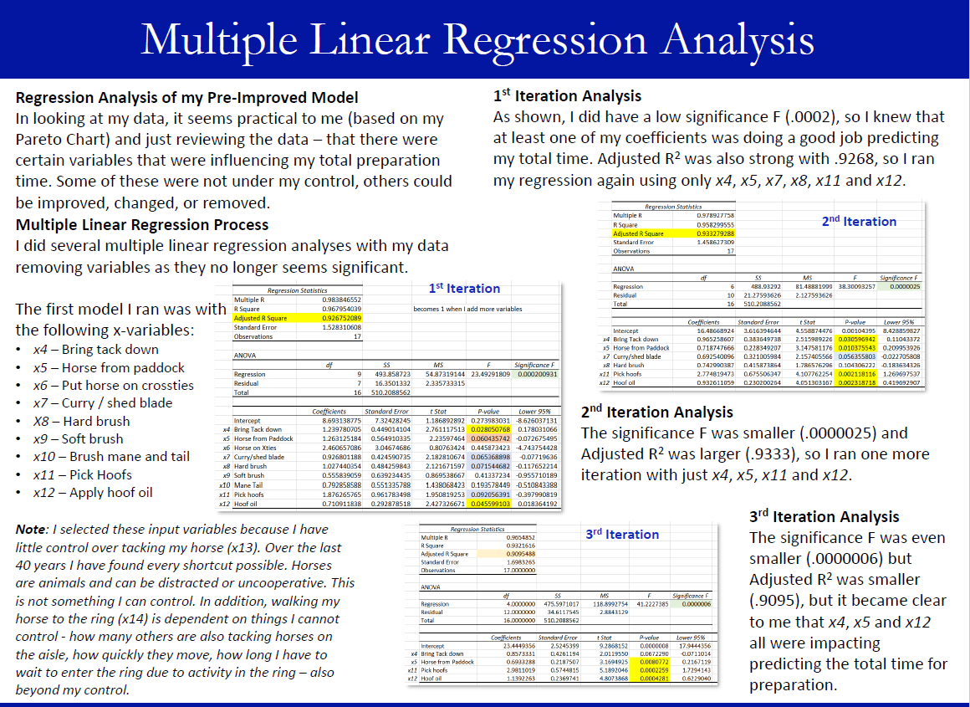
Horse Ride Preparation Process Improvement
Notes:
In Data Analysis and Decision Making, the class was asked to select a topic of interest for process improvement and then use statistical methods to determine if changes made in the process actually achieved improvement. This project very directly addressed how to use analyses to develop a plan of action to implement business decisions. A very interesting concept in this class was the idea of Define – Measure – Analyze – Improve – Control which was the approach taken for the final project. Staying with my original theme of equestrian/equine related topics, it was determined that this course provided the opportunity to solve a problem that I experienced with my own riding—streamlining the process of “preparing” to ride (or the grooming and tacking process). For the project, there needed to be a compelling reason with related impacts for lack of improvements; such as, costs, negative impacts (deterioration of the horse) among other things. In this example, a nonexercised horse suffers ailments similar to humans that are not physically fit – bad joints, swelling, arthritis and more. In addition, this results in pain for the animal as well as substantial veterinary bills.
The initial slide for the final presentation needed to portray all key data in a single view as shown in the previous figure. Then the subsequent presentation slides took a deeper look at individual components of the analysis.
By mapping the existing process using flowcharting tools, areas of improvement were immediately apparent. Using this process map as a guide, a data measurement plan was developed which included the specific data points to gather at each step in the process along with a time period for pre-improvement data collection. This was accomplished by researching tools to assist in setting tasks and then timing each task. The results were downloaded in spreadsheet form to be used in statistical analysis to attempt to improve the process. The data combined learning components of the course by utilizing different variable types: both discrete and continuous data were collected for the independent variables with a dependent variable as the overall preparation time for riding. Improvement goals were developed to measure success.
Then specific statistical methods were used to understand the data and to determine where improvements could be gained in the process. Summary statistics were reported to review the baseline pre-improvement time and how many standard deviations of improvement could be shaved off the initial process to minimize preparation time in order to achieve more time in the saddle.
The previous figure shows the Sigma Quality Level which was used to compare pre and post improvement data and measure the success of the process improvement. Reporting these initial statistics helped to gain initial insight, but did not point to specific areas in the process that could be altered to minimize the pre-improvement process times.
For example, using Multiple Linear Regression analysis helped to narrow down specific areas that were directly affecting the time required to prepare to ride by reviewing the significance of each variable. Using this method and multiple iterations, it became clear what tasks should be modified to achieve improvements. The results of this analysis can be found in the following figure.
Describing a broad overview of the major practice areas of data science.
Process improvement is a very important concept that businesses investigate in multiple areas of the operations. By articulating the methods used to identify and achieve process improvements, the concept of describing a broad overview of the major practice areas of data science was achieved. The final presentation for this course included the discussion of statistical methods and areas of data science that can be used to create, verify and prove assumptions. For example, using the Sigma Quality Level and performing various statistical tests – hypothesis testing, multiple linear regression analysis, and then generating control charts are examples of utilizing practice areas of data science to achieve results.
Collecting and organizing data.
As with the previous course, data collection and organization were key to achieving the goals laid out for the final project. Learning new tools for data collection and organizing this data laid the foundation for this project. Using the “ATracker” program to collect the data was an excellent way to capture information for each possible task or component for improvement. This data was then easy to use for the process improvement project and it was a great way to keep the data organized.
Developing a plan of action to implement the business decisions derived from the analyses.
One component of the project was to implement different approaches and tests to determine as well as prove that improvement was achieved. This often required reviewing the data from a different perspective or taking a different direction. For example, using the Define – Measure – Analyze – Improve – Control approach showed a clear plan for determining if process improvement could be achieved in this scenario. Each step had an associated time period for capturing data related to this stage in the process. By clearly capturing each component, the improvement areas were easily distinguishable and business decisions could be derived from data analysis.
Developing alternative strategies based on the data.
A plan of action was developed to implement and test the business solutions made to improve the process as derived from the analysis completed. By documenting the individual tasks and how each could be modified, if applicable, the data presenting alternative strategies to narrow down improvement areas and to show that success was achieved. Determining defects and then testing the hypothesis that improvements could be made led to multiple linear regression and additional testing. Another example was the use of Pareto Charts and additional testing with the Chi Squared test for independence around horse location – all which were dictated by the data and looking at alternative strategies to determine how to improve the process.
Demonstrating communication skills regarding data and its analysis for managers, IT professionals, programmers, statisticians, and other relevant professionals in their organization.
Finally, as with all courses I took in this program, documenting the approach and findings help to improve and fine tune communication skills. This project, using a PowerPoint presentation format that needed to play the role of a document summarizing the project, was new to me and allowed me to use a more creative side to lay out the slides in a readable manner as they had far too much text to actually be used in presentation form.

Slide 15
Learning Objectives Satisfied
Describing a broad overview of the major practice areas of data science
Collecting and organization data
Developing a plan of action to implement the business decisions derived from analysis
Developing alternative strategies based on data
Demonstrating communication skills regarding data and its analysis for managers, IT professionals, programmers, statisticians, and other relevant professionals in their organization
Notes:
To summarize, the following learning objectives were satisfied by the project work in IST 707 - Data Analytics
Describing a broad overview of the major practice areas of data science
Collecting and organization data
Developing a plan of action to implement the business decisions derived from analysis
Developing alternative strategies based on data
Demonstrating communication skills regarding data and its analysis for managers, IT professionals, programmers, statisticians, and other relevant professionals in their organization

Slide 16
IST 707
Data Analytics
Professor Jeremy Bolton
Notes:
Under the guidance of Jeremy Bolton, I feel the next project that assisted me to satisfy the learning objectives was IST 707 Data Analytics.

Slide 17
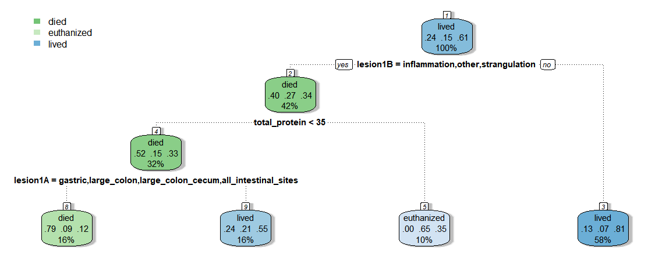
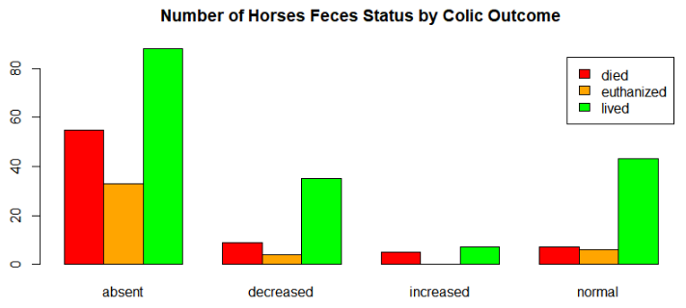
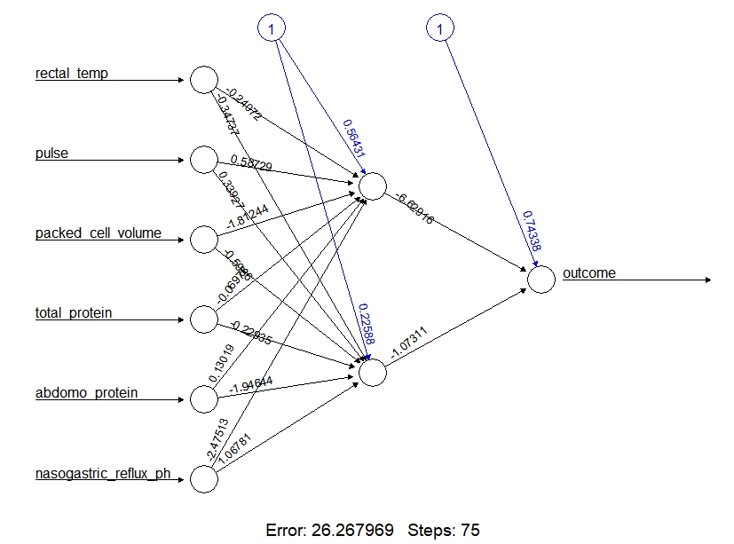
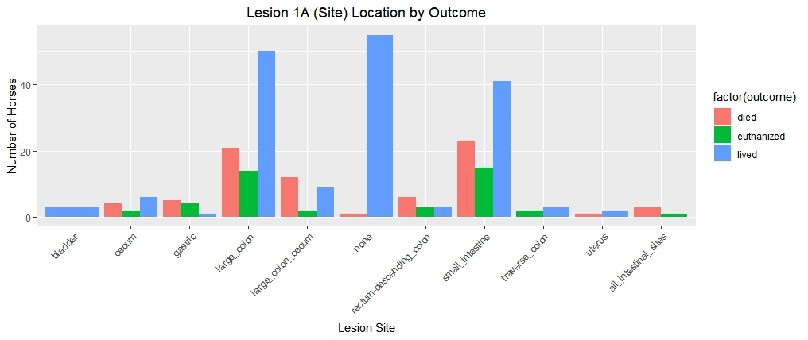
Predicting Horse Colic
Notes:
Data Analytics provided a platform for understanding how to predict or determine if an outcome could be forecasted from the past data outcomes. This was an excellent platform for working with equines again with the effort focusing on determining if the outcome of a horse colic could be predicted with certain medical presented conditions. It is important to understand that among domesticated horses, colic is the leading cause of premature death. Equine colic is a fairly common disorder of the digestive system. Although the definition means “abdominal plain” – the term in horses is a condition of severe abdominal discomfort which presents with pawing, rolling, and sometimes the inability to defecate.
There are many causes of colic – but some are fatal without surgical intervention. Colic surgery is usually an expensive procedure as it is major abdominal surgery, often with intensive aftercare. A horse has about a 10% chance to colic over his/her lifetime. Between 25% and 30% of horses presented with colic symptoms are recommended to go to surgery. In those cases, between five and 10 percent will be humanely euthanized because of a poor prognosis or economic considerations.
This project was one of the most interesting and probably the biggest learning opportunity for me in the program and close to my heart, because I lost a horse to colic – she was euthanized on the operating table. I had a bit of an advantage with this dataset because I had some general knowledge in what area might be of interest and might be a contributing component to colic prognosis. The figure shown below looks specifically at the fecal output per outcome for the horses in the dataset. This is important because when a horse is suffering from colic, the lack of fecal output can mean that an intestine is twisted causing the pain. As can be seen in this figure, there are certain fecal status that seem to be related to the colic outcome (specifically, absent or decreased).
With that information, it was also important to visualize if there were any specific lesions ad where they were and how that might play a role in colic outcome as show in the following figure. This visualization, although similar, provide more insight into the data to prepare for modeling and prediction.
With this established information, it was time to being looking into prediction and which models provided the best accuracy for predicting the colic outcome. This was a wonderful learning experience around selecting the appropriate statistical model, fine tuning the model appropriately, visualizing that model and the outcomes and then interpreting the results. Decision trees and random forests were discussed in class. The best decision tree can find, but taking the time to try different models and components help to improve the accuracy. This was very important as accuracy can be improved, but you can use too much information making the model overly complex. There is a fine line between the simple or pruned model and the overly complex model. Keeping this in mind, a pruned model was developed as shown in the following figure.
As per our initial visualization, the location of the lesion and type played an initial role in colic outcome prediction followed by blood protein and further lesion information. Using this simple model, the outcome of died, lived or euthanized could be determined with some level of accuracy. Neural networks were then reviewed to predict outcome. Two hidden nodes were introduced to obtain the following neural network with 75 steps and an error of 26.267969 as show in the figure below.
Additional models were reviewed including Random Forests, Association Rule Mining and my introduction to Naïve Bayes and the importance cross-validation and the confusion matrix. The best results were found using Support Vector Machines which I was able to use in other classes with the knowledge gained in this course.
Learning Objectives Satisfied
Among the concepts mastered in this course, the following were most closely mapped to the goals of the Syracuse Applied Data Science Program:
Identifying patterns in data via visualization, statistical analysis, and data mining.
By creating initial visualizations, patterns and other insight became apparent in the data set. Although I had some initial knowledge of the symptoms that are often seen in a horse that is experiencing a colic episode, the visualization of related variables was very helpful and uncovered additional patterns in the data by reviewing certain variable combinations with others. This information helped to determine which variables might be relevant when addressing the prediction with statistical modeling.
Developing alternative strategies based on the data.
As mentioned previously, many different models were executed to find the best model for predicting colic outcomes for the data set selected. For example, as shown with decision trees, trees were created and pruned to arrive at the optimal model. Working with neural networks provided a alternative look at the data from a new perspective. In addition, Support Vector Machines with different kernels were used to arrive on the best model and kernel for predicting the outcome. By reviewing the data and interpreting results of models, alternative strategies were used to arrive at a more optimal model.
Developing a plan of action to implement the business decisions derived from the analyses.
As part of this project, a plan was created, with Professor Bolton’s guidance, to begin to understand the data and then attempt different models for colic prediction based on what was seen in initial observations. As shown in the conclusion for this project, understanding the key components or symptoms, veterinarians can approach colic incidents with a new insight. They can check these symptoms first and possibly make a more informed and faster decision that could possibly save horses lives. By understanding the results from the analyses, plans like this can be put into place for the future.

Slide 18
Learning Objectives Satisfied
Identifying patterns in data via visualization, statistical analysis, and data mining
Developing alternative strategies based on data
Developing a plan of action to implement the business decisions derived from the analyses
Notes:
To summarize, the following learning objectives were satisfied by the project work in IST 659 - Data Administration Concepts and Database Management:

Slide 19
IST 719
Information Visualization
Professor Gary Krudys
Notes:
This leads me to one of my favorite courses and one that taught me tools that I use everyday at my current position as an Instructional Designer at a software company. Gary Krudys also proved to be one of my favorite instructors.

Slide 20
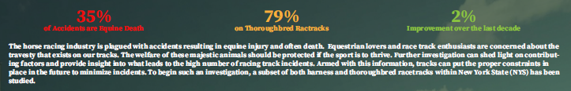
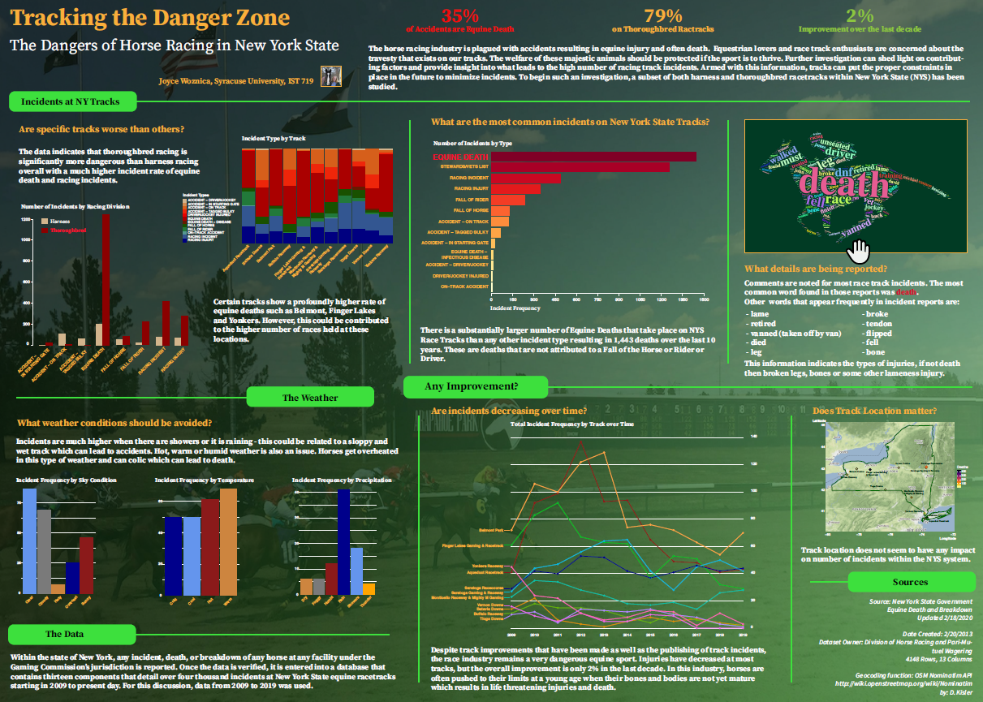
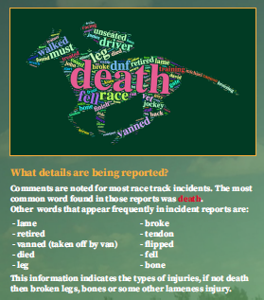
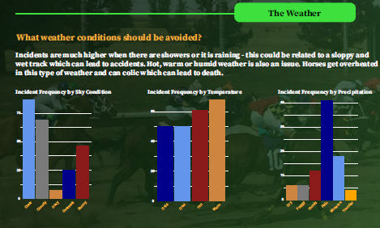
Tracking the Danger Zone Horse Track Incidents
Notes:
The course on Information Visualization might have been my favorite in the program. Learning how to properly present information to different audiences to assure that the findings are clear and obvious was of great value. There were very important topics covered in this course around drawing the eye of the consumer, how to present a consistent theme, simplifying graphics and focusing the reader on the areas of interest and more. The final project in this course was to prepare a full-sized poster for the project which was then presented to the class. A scaled version of this final poster can be found in the following figure.
As with other projects, I continued with a theme of horses, but focused on how to improve safety on the racetrack using a public set of data provided by the New York State Gaming Commission. Within the state of New York, any incident, death, or breakdown of any horse, as well as jockey and driver accidents, at any facility under the Gaming Commission’s jurisdiction is reported to the Presiding Judge or Stewart at that facility. This individual then provides the details of the incident to the Commission’s main office in Schenectady, New York. The verified data is entered into a database that contains 13 components that detail over 4,000 incidents at New York State equine racetracks between March 4, 2009 to present day. This data is updated daily (Woznica, Tracking the Danger Zone, 4). Ironically, my eldest daughter now works for the Tioga Downs racetrack taking blood from the winners to test for illegal substances.
This course provided great insight into how people consume information and how to use that to draw attention to results in data analysis. For example, providing some key statistics in an easy-to-read manner and large font draws the consumers eye and provides immediate understanding into the data being analyzed. As shown below, some percentages of information about the data to bring the reader into the story being told and heighten their interest.
Another thing that was reviewed as part of this exercise was looking at words that could be found in the incident description and what could be determined by looking at this information. By presenting top words from the incident descriptions in the shape of a racing horse provided a way to draw the consumer’s focus as well as a very apropos way to present the information. This exercise did show some insight into the most common ailments in the incident’s reports.
In reviewing the data and applying some of my knowledge of horse injury and the strains on joints when galloping around a track at a young age, I started to look at information that I felt might have some influence on the racing incident outcome. The first of these was related to the weather. Running on a wet track can make it very slippery and can also affect the ability to see what is in front of you and running on a very cold or hard track due to cold temperatures are harder on the joints and can cause injury to the horse. This was detailed in the segment of the poster displayed in the following figure where weather conditions and racing outcomes were reviewed in visualization.
By taking this course, it became very apparent how the important the display and dissemination of analysis results can be as part of the overall process of data analysis.
Identifying patterns in data via visualization, statistical analysis, and data mining.
As this was a visualization course, the process of imagining the overall layout and how to present graphics and plots in the best way to showcase the results was stressed each week. We learned how to manipulate plots using Adobe Illustrator to make them more aesthetically pleasing and to clearly display the desired information. I feel this skill will be very useful in the future as it is a key component to communicating results to key stakeholders and executives.
Demonstrating communication skills regarding data and its analysis for managers, IT professionals, programmers, statisticians, and other relevant professionals in their organization.
One of the most difficult components of data analytics, in my opinion, is to communicate the results of any analysis to managers, executives and other relevant professionals. By finding new ways to present graphics and plots and portray the information in appropriate visualizations, I was able to demonstrate how to communicate the results of data analysis to various individuals within an organization. At the end of this course, our final poster was presented to the class zooming in on certain areas to discuss specifics of the data visualizations. This is a skill that will be used throughout my career.
Synthesizing the ethical dimensions of data science practice (e.g., privacy).
One of the most difficult things in this course was finding a data set of interest that was public information that was available for analysis. So much information today is protected via privacy laws and more. It is key to know what protects personal information (PII) and laws around using this information is extremely important. For the past 20+ years, I have worked in electronic content management and governance, so this is a topic that is well understood by myself and customers. Understanding what can be used and not used is a key to data science. In this situation, I was lucky that New York State publishes this information readily and updates it daily. This is very rare as I could find no other information similar from any other tracks as they do not make this information public.

Slide 21
Learning Objectives Satisfied
Identifying patterns in data via visualization, statistical analysis, and data mining
Demonstrating communication skills regarding data and its analysis for managers, IT professionals, programmers, statisticians, and other relevant professionals in their organization
Synthesizing the ethical dimensions of data science practice (e.g. privacy)

Slide 22
IST 652
Scripting for Data Analytics
Professor Deborah Landowski

Slide 23
Racetrack Infractions and Incidents

Slide 24
Learning Objectives Satisfied
Collecting and organization data
Identifying patterns in data via visualization, statistical analysis, and data mining
Developing alternative strategies based on data
Developing a plan of action to implement the business decisions derived from the analysis
Demonstrating communication skills regarding data and its analysis for managers, IT professionals, programmers, statisticians, and other relevant professionals in their organization
Synthesizing the ethical dimensions of data science practice (e.g. privacy)

Slide 25
IST 664
Natural Language Processing
Professor Norma Palomino

Slide 26
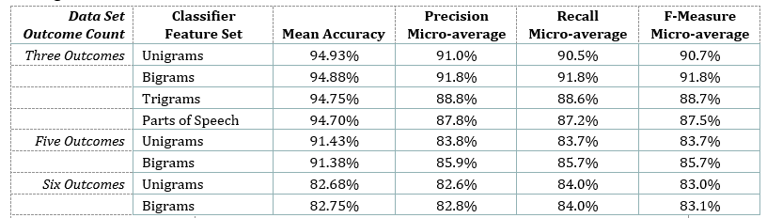
Classification of Racetrack Incidents
Replace with your own text

Slide 27
Learning Objectives Satisfied
Identifying patterns in data via visualization, statistical analysis, and data mining
Developing alternative strategies based on data
Demonstrating communication skills regarding data and its analysis for managers, IT professionals, programmers, statisticians, and other relevant professionals in their organization

Slide 28
04
Summary

Slide 29
Summary of Projects and Objectives
Course | Objectives Satisfied
IST 659 – Data Administration and Database Management | Collecting and organization data Identifying patterns in data via visualization, statistical analysis, and data mining Developing a plan of action to implement the business decisions derived from analysis Demonstrating communication skills regarding data and its analysis for managers, IT professionals, programmers, statisticians, and other relevant professionals in their organization
MBC 638 – Data Analysis and Decision Making | Describing a broad overview of the major practice areas of data science Collecting and organization data Developing a plan of action to implement the business decisions derived from analysis Developing alternative strategies based on data Demonstrating communication skills regarding data and its analysis for managers, IT professionals, programmers, statisticians, and other relevant professionals in their organization
IST 707 – Data Analytics | Identifying patterns in data via visualization, statistical analysis, and data mining Developing alternative strategies based on data Developing a plan of action to implement the business decisions derived from the analyses
Notes:
IST 659 - Data Administration Concepts and Database Management
MBC 638 - Data Analysis and Decision Making
IST 707 - Data Analytics
IST 719 - Information Visualization
IST 652 - Scripting for Data Analytics
IST 664 - Natural Language Processing

Slide 30
Summary of Projects and Objectives
Course | Objectives Satisfied
IST 719 – Information Visualization | Identifying patterns in data via visualization, statistical analysis, and data mining Demonstrating communication skills regarding data and its analysis for managers, IT professionals, programmers, statisticians, and other relevant professionals in their organization Synthesizing the ethical dimensions of data science practice (e.g. privacy)
IST 652 – Scripting for Data Analytics | Collecting and organization data Identifying patterns in data via visualization, statistical analysis, and data mining Developing alternative strategies based on data Developing a plan of action to implement the business decisions derived from the analysis Demonstrating communication skills regarding data and its analysis for managers, IT professionals, programmers, statisticians, and other relevant professionals in their organization Synthesizing the ethical dimensions of data science practice (e.g. privacy)
IST 664 – Natural Language Processing | Identifying patterns in data via visualization, statistical analysis, and data mining Developing alternative strategies based on data Demonstrating communication skills regarding data and its analysis for managers, IT professionals, programmers, statisticians, and other relevant professionals in their organization
Notes:
IST 659 - Data Administration Concepts and Database Management
MBC 638 - Data Analysis and Decision Making
IST 707 - Data Analytics
IST 719 - Information Visualization
IST 652 - Scripting for Data Analytics
IST 664 - Natural Language Processing

Slide 31
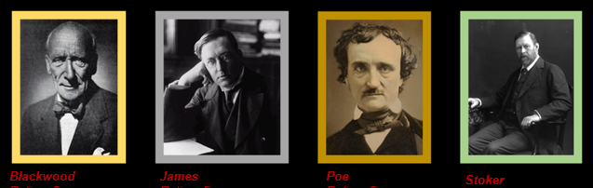
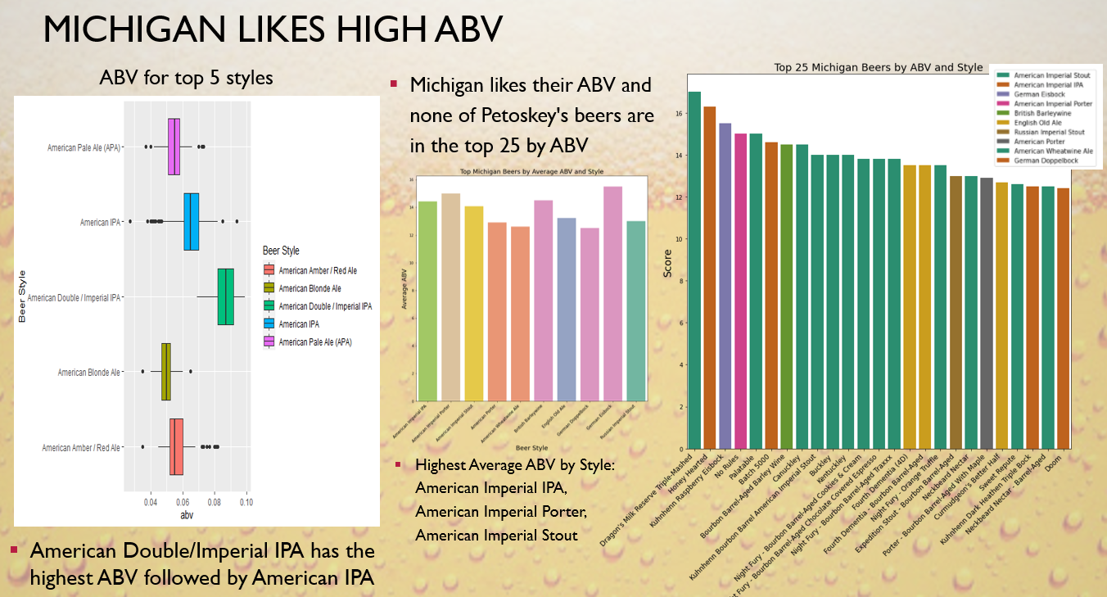
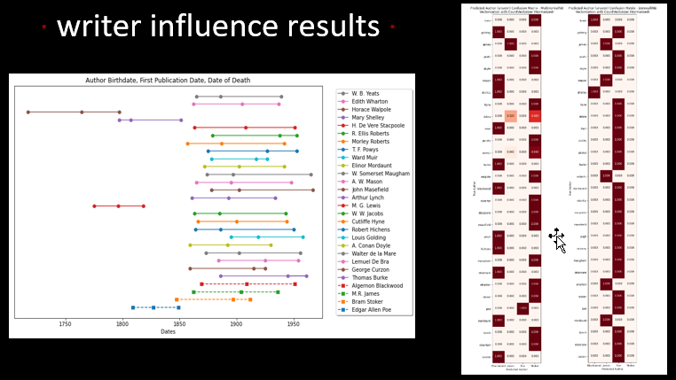

Other Projects

Slide 32
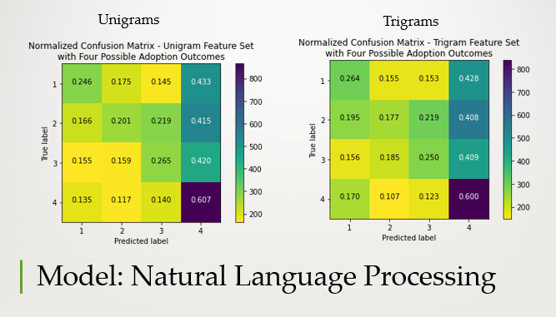
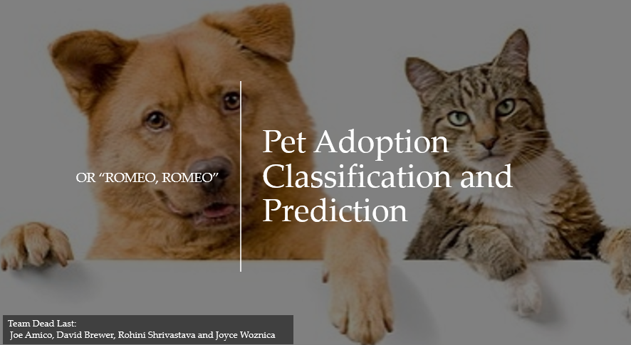
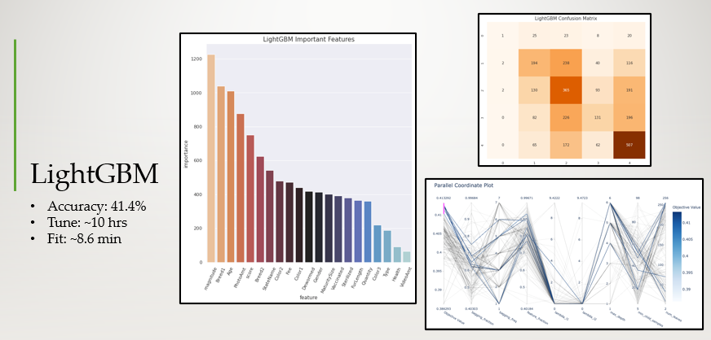
Other Projects

Slide 33
05
Reflection
Notes:
Ok – let’s wrap this up with some reflection on the subject

Slide 34
My Reflection

Slide 35
THANK YOU
Special Thanks to:
Dr. Jason Anastasopoulos
Jeremy Bolton
Dr, Jon Fox
Dr. Ami Gates
Lynn Gill
Chad Harper
Dr. Don Harter
Gary Krudys
Deborah Landowski
Dr. Norma Palomino
Raj Venkatesan
Notes:
Thank you for your time today. I have enjoyed my time and Syracuse University and want to take a moment to thank my professors in the program for their time and devotion to their students.

